Slide 1


Marijuana: Trends & Implications for Treatment by Brady Byrne

Slide 2
Overview
Usage and Demographic Trends of Marijuana Across the US
Prevalence and Treatment of Cannabis Use Disorder (CUD)
Health Implications According to Research
Medical Applications: Benefits and Limitations
Effective Modalities for Treatment
Public Health & Prevention

Slide 3
Usage Trends
Changes in policy and public opinion have affected usage rates across the US and Canada since 1996 (first legalization for medical use in CA) (Findlaw, 2019; WHO, 2019).
Trends indicate a relatively stable pattern of use in adolescents (12-17) while rates in young adult use (18-24) have increased since 2002 (SAMHSA, 2018).
Meanwhile, alcohol, combustible tobacco products, and non-marijuana illicit drug use among U.S. adolescents ages 12–17 years have all decreased since 2002 (SAMHSA, 2018).
However, the potency and methods of use have changed with legalization, leading to greater health risks, particularly for adolescent-staged use of cannabis.

Slide 4
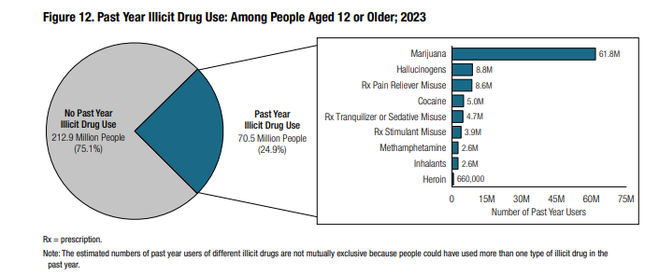
Usage Trends (SAMHSA, 2024)

Slide 5
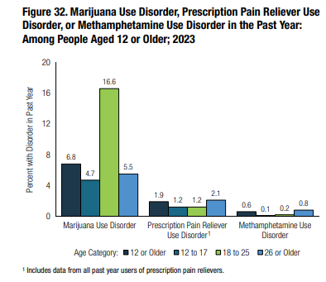
Usage Trends
(SAMHSA, 2024)

Slide 6
Usage Trajectories
Studies identify different trajectories for sporadic and chronic use.
Those who use only sporadically do not show trends of increased psychiatric problems or delinquency.
Those who use persistently and develop chronic use have been associated with higher likelihood of psychiatric problems and delinquency (Lee et al., 2018; Swift et al., 2008;)
Preventative measures may therefore focus on youth who are at elevated risk for developing persistent/chronic high cannabis use.
Fewer individuals are seeking treatment for CUD due to shifts in public perception regarding its negative outcomes.
48% decrease in the total number of cannabis-related admissions between 2005 and 2015 (SAMHSA, 2017).

Slide 7
Health Implications
Adolescents who report chronic early use have been associated with impairments to attention, memory, executive functioning, and cognitive processing. (Dougherty et al., 2013; Gruber, Sagar, Dahlgren, Racine, & Lukas, 2012; Jacobus, Bava, Cohen-Zion, Mahmood, & Tapert, 2009).
In studies exploring the effects of abstinence after chronic use, improvements in memory and processing have been demonstrated while attention and inhibition have remained somewhat impaired (Hanson et al., 2010).
It is unclear whether cognitive impairments following chronic use are permanent.
Longitudinal research indicates that the onset period and length of abstinence result in longer term recovery of cognitive functioning (Mokrysz et al., 2016; Tait, Mackinnon, & Christensen, 2011).
Young adults do not indicate the same levels of risk for cognitive impairments (Fontes et al., 2011; Gruber et al., 2012; Pope et al., 2003).
Studies are associative and do not indicate causaility.

Slide 8
Medical Applications: Benefits and Limitations
Many adolescents report using cannabis to self-medicate for anxiety and depression (Hyman & Sinha, 2009).
When applied in clinical studies, low-doses have shown to reduce anxiety in adults while high doses may increase anxiety levels (Bloomfield et al., 2019).
Medical marijuana practices are not standardized across states, therefore effectiveness is difficult to track with consistency.
Some studies show strong associations between cannabis use while others show none. Results are inconclusive and further longitudinal data is needed.
Age of onset, potency, and consistency of use are clear factors for potential negative or positive outcomes.

Slide 9
Treatment Modalities
Biopsychosocial model of treatment
  Biological considerations for anxiety and depressive disorders
  Psychological treatment modalities
  Social Determinates of Health (SDOH) to consider
Treatment of SUD and co-occurring
  Addiction invovlves categorical behaviors of avoidance, impulsivity, and health compromise.
Effectiveness of therapeutic interventions for anxiety and depression
Multidimensional approach to treatment
Importance of community and continuing care

Slide 10
Public Health & Prevention
The legalization of marijuana has led to changes in public perception, potency, and methods of use.
While adolescent usage trends have remained stable, young adults are using at increased rates.
Adolescents are the most at-risk group for cognitive impairments and delinquency.
It is inconclusive whether negative effects are permanent, or whether marijuana use has a causal relationship with anxiety or mood disorders.
If youth are using to self-medicate for anxiety, either more consistent research into medical marijuana’s use is needed, or alternative treatment must be equally as effective.
Understanding of the problems and its treatment require a multidimensional approach, considering biological, psychological, and social risk and protective factors.

Slide 11
References
Findlaw. (2019). Marijuana Legalization and Decriminalization Overview Retrieved from https://criminal.findlaw.com/criminal-charges/marijuana-legalization-and-decriminalization-overview.html
WHO. (2019). The health and social effects of nonmedical cannabis use. In.
SAMHSA. (2018). Key substance use and mental health indicators in the United States: Results from the 2016 National Survey on Drug Use and Health (HHS Publication No. SMA 17–5044, NSDUH Series H-52) Retrieved from Rockville, MD: [Google Scholar]
Substance Abuse and Mental Health Services Administration. (2024). Key substance use and mental health indicators in the United States: Results from the 2023 National Survey on Drug Use and Health (HHS Publication No. PEP24-07-021, NSDUH Series H-59). Center for Behavioral Health Statistics and Quality, Substance Abuse and Mental Health Services Administration. https://www.samhsa.gov/data/report/2023-nsduh-annual-national-repor
Windle M, & Wiesner M (2004). Trajectories of marijuana use from adolescence to young adulthood: predictors and outcomes. Dev Psychopathol, 16(4), 1007–1027. [DOI] [PubMed] [Google Scholar]
Swift W, Coffey C, Carlin JB, Degenhardt L, & Patton GC (2008). Adolescent cannabis users at 24 years: trajectories to regular weekly use and dependence in young adulthood. Addiction, 103(8), 1361–1370. doi: 10.1111/j.1360-0443.2008.02246.x [DOI] [PubMed] [Google Scholar]
Lee JY, Brook JS, Finch SJ, & Brook DW (2018). Trajectories of cannabis use beginning in adolescence associated with symptoms of posttraumatic stress disorder in the mid-thirties. Subst Abus, 39(1), 39–45. doi: 10.1080/08897077.2017.1363121 [DOI] [PMC free article] [PubMed] [Google Scholar]
Substance Abuse and Mental Health Services Administration (SAMHSA), Center for Behavioral Health Statistics and Quality. (2017). Treatment Episode Data Set (TEDS): 2005–2015. National Admissions to Substance Abuse Treatment Services. BHSIS Series S-91, HHS Publication No. (SMA) 17–5037 Rockville, MD: Substance Abuse and Mental Health Services Administration. [Google Scholar]
Hanson KL, Winward JL, Schweinsburg AD, Medina KL, Brown SA, & Tapert SF (2010). Longitudinal study of cognition among adolescent marijuana users over three weeks of abstinence. Addict Behav, 35(11), 970–976. doi: 10.1016/j.addbeh.2010.06.012 [DOI] [PMC free article] [PubMed] [Google Scholar]

Slide 12
References
Dougherty DM, Mathias CW, Dawes MA, Furr RM, Charles NE, Liguori A, … Acheson A (2013). Impulsivity, attention, memory, and decision-making among adolescent marijuana users. Psychopharmacology (Berl), 226(2), 307–319. doi: 10.1007/s00213-012-2908-5 [DOI] [PMC free article] [PubMed] [Google Scholar]
Jacobus J, Bava S, Cohen-Zion M, Mahmood O, & Tapert SF (2009). Functional consequences of marijuana use in adolescents. Pharmacol Biochem Behav, 92(4), 559–565. doi: 10.1016/j.pbb.2009.04.001 [DOI] [PMC free article] [PubMed] [Google Scholar]
Mokrysz C, Landy R, Gage SH, Munafò MR, Roiser JP, & Curran HV (2016). Are IQ and educational outcomes in teenagers related to their cannabis use? A prospective cohort study. Journal of psychopharmacology (Oxford, England), 30(2), 159–168. doi: 10.1177/0269881115622241 [DOI] [PMC free article] [PubMed] [Google Scholar]
Tait RJ, Mackinnon A, & Christensen H (2011). Cannabis use and cognitive function: 8-year trajectory in a young adult cohort. Addiction, 106(12), 2195–2203. doi: 10.1111/j.1360-0443.2011.03574.x [DOI] [PubMed] [Google Scholar]
Hyman SM, & Sinha R (2009). Stress-related factors in cannabis use and misuse: implications for prevention and treatment. J Subst Abuse Treat, 36(4), 400–413. doi: 10.1016/j.jsat.2008.08.005 [DOI] [PMC free article] [PubMed] [Google Scholar]
Fontes MA, Bolla KI, Cunha PJ, Almeida PP, Jungerman F, Laranjeira RR, … Lacerda ALT (2011). Cannabis use before age 15 and subsequent executive functioning. British Journal of Psychiatry, 198(6), 442–447. doi: 10.1192/bjp.bp.110.077479 [DOI] [PubMed] [Google Scholar]
Gruber SA, Sagar KA, Dahlgren MK, Racine M, & Lukas SE (2012). Age of onset of marijuana use and executive function. Psychol Addict Behav, 26(3), 496–506. doi: 10.1037/a0026269 [DOI] [PMC free article] [PubMed] [Google Scholar]
Pope HG, Gruber AJ, Hudson JI, Cohane G, Huestis MA, & Yurgelun-Todd D (2003). Early-onset cannabis use and cognitive deficits: what is the nature of the association? Drug and Alcohol Dependence, 69(3), 303–310. doi: 10.1016/S0376-8716(02)00334-4 [DOI] [PubMed] [Google Scholar]
Bloomfield MAP, Hindocha C, Green SF, Wall MB, Lees R, Petrilli K, … Freeman TP (2019). The neuropsychopharmacology of cannabis: A review of human imaging studies. Pharmacology & Therapeutics, 195, 132–161. doi: 10.1016/j.pharmthera.2018.10.006 [DOI] [PMC free article] [PubMed] [Google Scholar]

Slide 13
Thank you
Brady Byrne
bbyrne@northsightrecovery.com
northsightrecovery.com

